Slide 1


TIC-TAC-TOE
ADVANCE CONTACT SEARCH
TEAM MEMBERS:
GUIDE’S NAME
k.Siddhartha (2451-10-737-081)
B.Pranay (2451-10-737-080)
Mohemmad Ali (2451-10-737-086)
P.Karthik
Designation: Asst. professor,
Department of Information Technology

Slide 2
Statement of problem:
Generally most of the contact search will provide option search only by name, so we provide a search in contacts for skills and their occupation by which user can make effective search of the resources provided to him
Scope of work:
*Creation of contact search app for android
*Use of eclipse software to develop app
*Java language for business logic
*Xml pages for layout
*SQLite database for storage

Slide 3

APP-INFO
MAIN FRAME
SAVING PAGE
DISPLAY ALL
DISPLAY SELCETED ONCE
DISPLAY ALL SKILLS
CONTACTS

Slide 4
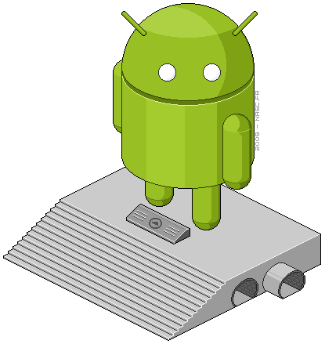
j individual contribution
Basic code-connecting different pages
logic for searching
creation of menus
Database -connecting to database
insertion, up gradation and deletion
retrieval of data in a desired format
Visualization- worked with different layouts
main frame
saving page
display pages etc

Slide 5
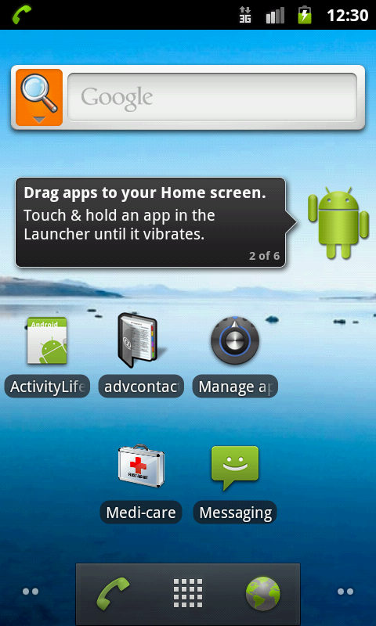
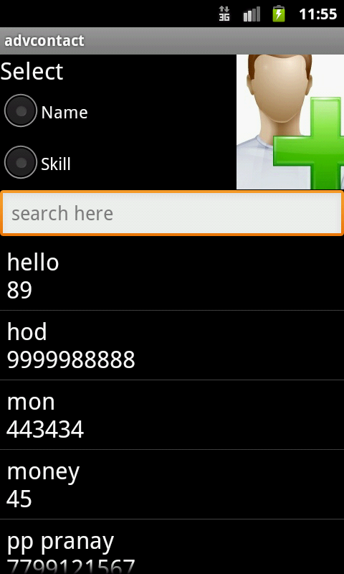

Slide 6
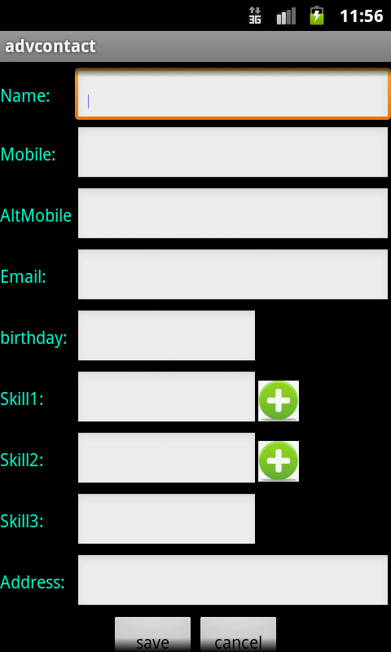
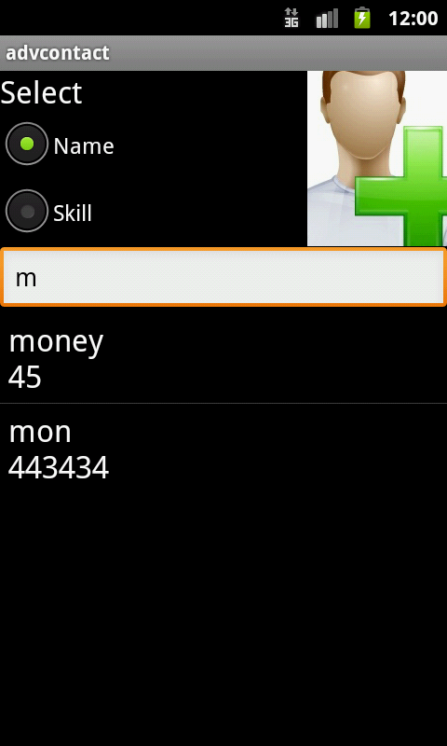

Slide 7
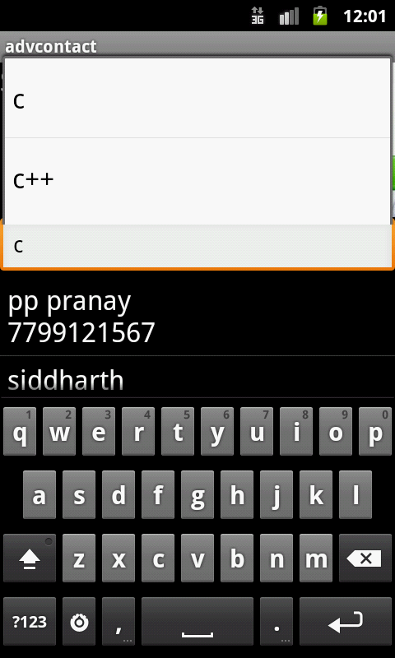
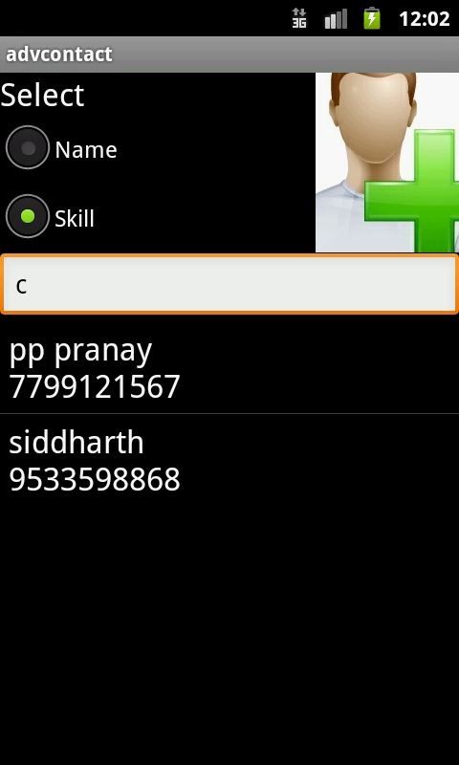

Slide 8
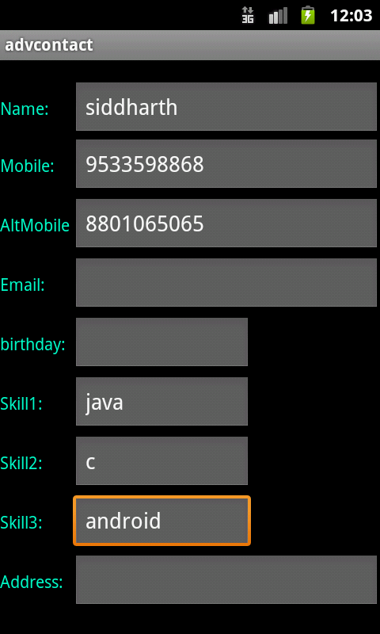
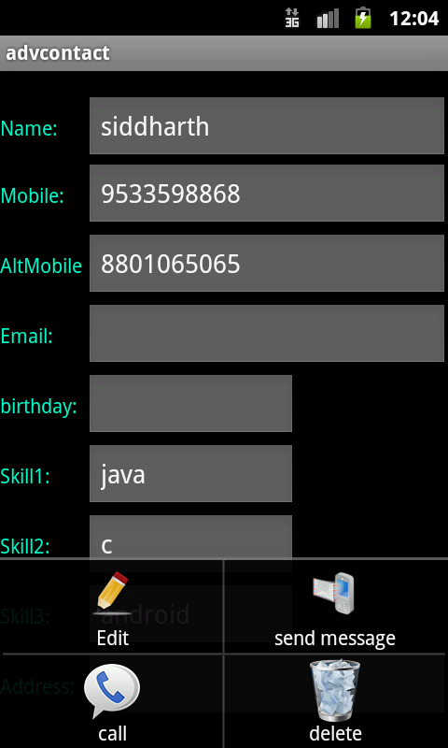

Slide 9
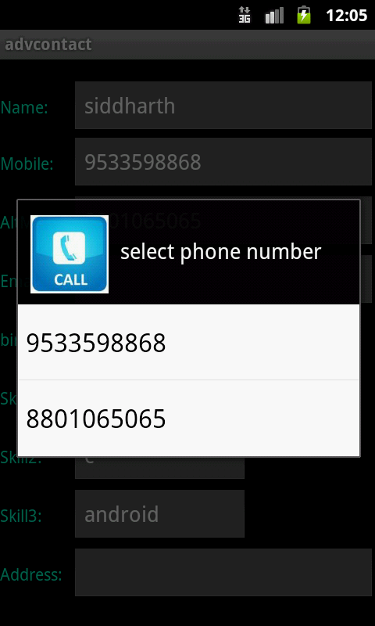
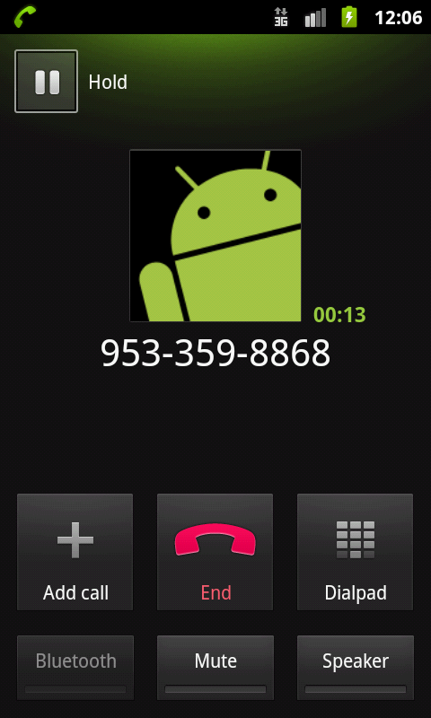

Slide 10
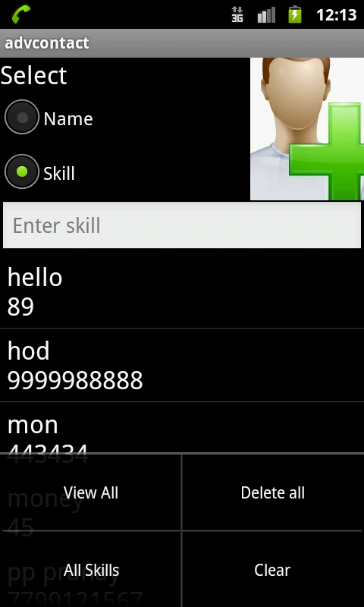
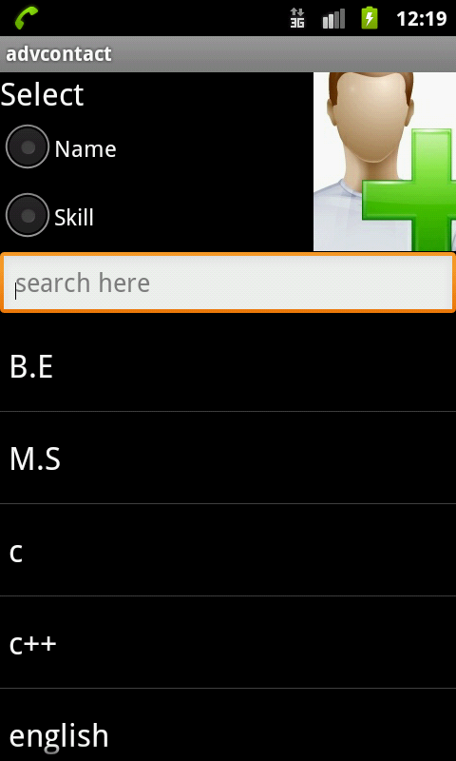

Slide 11
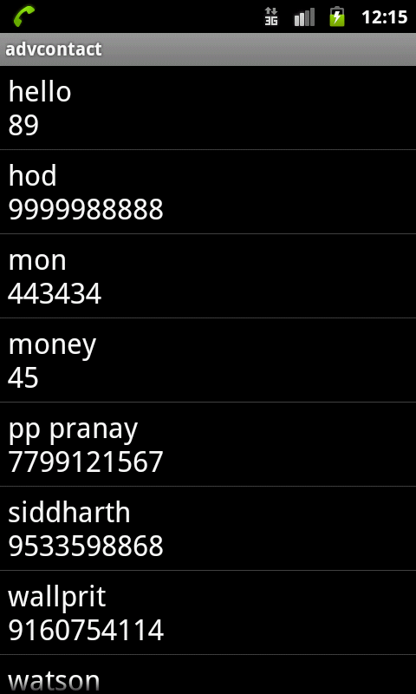
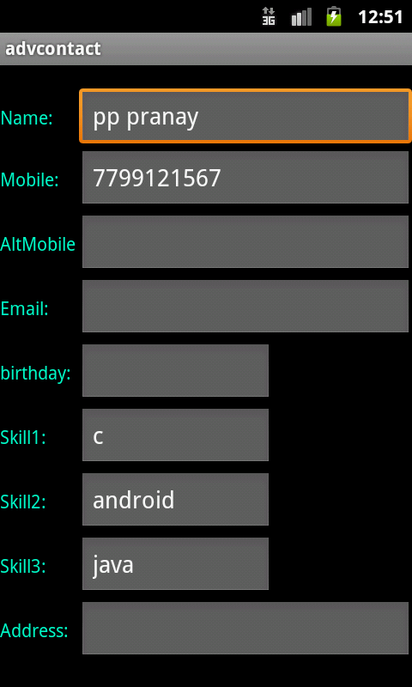

Slide 12
FUTURE DEVELOPMENTS
*Adding VOICE RECOGNIZATION to the app
*Implementing more searching mechanisms
*Adding images for contacts
*Creating backup and restore

Slide 13
Thank you

